Slide 1
Master-Thesis Methodical Approach for Analyzing Process Parameters and Optimizing Boundary Conditions in Multi-Axis Robot Programs
Status Update: Week 10 (13 weeks left)
11.12.2023 – 17.12.2023
Jan Nalivaika

Slide 2
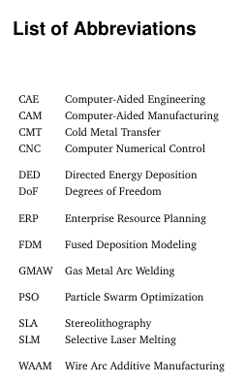
Progress
Exposee Done == DONE ☺
All Comments implemented == DONE ☺
Abbreviations == DONE ☺
Rundung in „Direction Changes“ analysieren == DONE ☺
Real Gcode == In the making
Images == In the making [TUM Farben]
Summery / Conclusion / Outlook schreiben == In the making

Slide 3
G - Commands
G60 = the points are reached exactly, but the feedrate is reducing to 0 at every waypoint
G641 = Bahnsteuerbetrieb mit Überschleifen nach Wegkriterium (ADIS=0.5)
GLOBALE BEFEHLE:
G601:
Befehl zum Aktivieren von Genauhalt-Kriterium "Genauhalt fein"
G602:
Befehl zum Aktivieren von Genauhalt-Kriterium "Genauhalt grob"

Slide 4
Real Gcode

Slide 5
Contact
Jan Nalivaika (TUM) Student Otto-Hahn-Ring 6
81739 Munich, Germany
Phone +49 163 7180148
E-mail jan.nalivaika.ext@siemens.com nalivaika@outlook.de
Marius Breuer (Siemens AG)
Supervisor Otto-Hahn-Ring 6
81739 Munich, Germany
Phone +49 (172) 8396287
E-mail marius.breuer@siemens.com
Ludwig Siebert (TUM-IBW)
Supervisor Boltzmannstr. 15
85748 Garching at Munich
Phone +49 (89) 289 – 15578
E-mail ludwig.siebert@iwb.tum.de

Slide 6
Christmas planning
DATE: Ludwig Marius Jan
08.12 ☺
15.12 ☺
22.12 ☺
29.12 X ☺
05.01 ☺
12.01 ☺
19.01 X
26.01 X
02.02 ☺

Slide 7
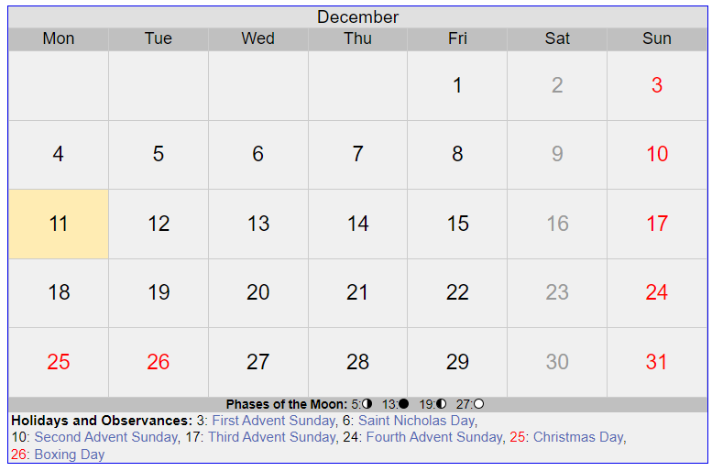
5 Tage
Dezember

Slide 8
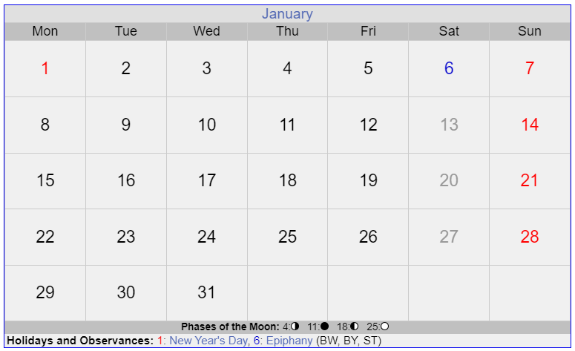
11 Tage
Januar

Slide 9
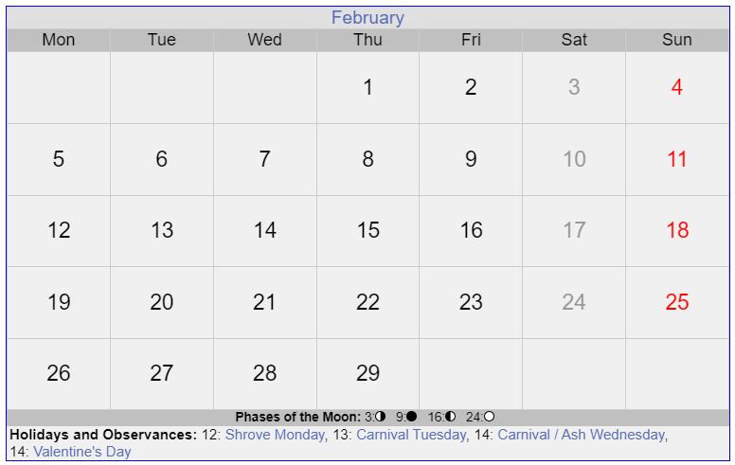
Final PDF
Paper
Paper
12 Tage
Januar

Slide 10
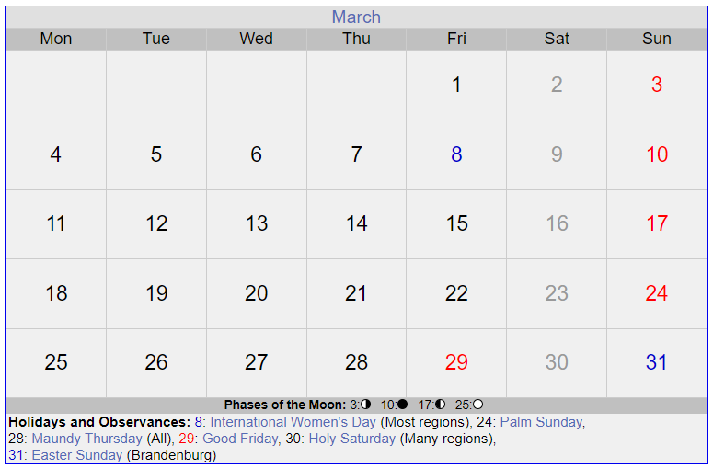
Paper
Paper
Verteidigung
PowerPoint für Verteidigung

